Slide 1

BHAVNA - Mixed language sentiment analysis
Group Members: Batch B Prateek Mehta (D17C/32) Alisha Punwani (D17C/43) Harsh Sachanandani (D17C/49)

Slide 2
Introduction
Code-mixed data is an important challenge of natural language processing,
A need for analysis tools for code-mixed data arises.
Although much research in multilingual and cross-lingual sentiment analysis has used semi-supervised or unsupervised methods, supervised methods still perform better.
Only a few datasets for popular languages such as English-Spanish, English-Hindi, and English-Chinese are available.
This project aims to bridge this gap and make sentiment analysis easier in mixed languages specifically for English-Hindi mixed text.

Slide 3
Description
Our aim is to solve the task of performing sentiment analysis on a mixed code text.
Using a twitter dataset on collated hindi-english dataset with good labels across 3 categories, Neutral, Positive, Negative.
LSTMs are the preferred model type used to tackle similar problems in other areas.
So we use a couple of LSTM models, one bidirectional and one single flow. Along with two convolutional networks to give a combined highly accurate result.

Slide 4
Methodology
We have trained a total of 4 sequential models on twitter based Hindi-English mixed text with good labels across 3 categories, Neutral, Positive, Negative.
They are sequential models with an average of 2.8 million trainable parameters
The models are fed spliced and tokenized strings with sequence lengths padded to 50 characters.
They were then trained to 10 epochs each. The LSTM models achieved an accuracy of 59%, whereas the CNN models performed slightly better at 62% accuracy.

Slide 5
Methodology
Model_name: "sequential"
_________________________________________________________________
Layer (type) Output Shape Param #
=================================================================
embedding (Embedding) (None, 50, 128) 2560000
_________________________________________________________________
bidirectional (Bidirectional (None, 256) 263168
_________________________________________________________________
dense (Dense) (None, 64) 16448
_________________________________________________________________
dense_1 (Dense) (None, 32) 2080
_________________________________________________________________
dense_2 (Dense) (None, 3) 99
=================================================================
Total params: 2,841,795
Trainable params: 2,841,795
Model_name: "sequential_3"
_________________________________________________________________
Layer (type) Output Shape Param #
=================================================================
embedding_3 (Embedding) (None, 50, 128) 2560000
_________________________________________________________________
conv1d_1 (Conv1D) (None, 48, 64) 24640
_________________________________________________________________
conv1d_2 (Conv1D) (None, 46, 32) 6176
_________________________________________________________________
conv1d_3 (Conv1D) (None, 44, 16) 1552
_________________________________________________________________
global_average_pooling1d_1 ( (None, 16) 0
_________________________________________________________________
dense_7 (Dense) (None, 8) 136
_________________________________________________________________
dense_8 (Dense) (None, 3) 27
=================================================================
Total params: 2,592,531
Trainable params: 2,592,531

Slide 6
Methodology
Model_name: "sequential_1"
_________________________________________________________________
Layer (type) Output Shape Param #
=================================================================
embedding_1 (Embedding) (None, 50, 128) 2560000
_________________________________________________________________
conv1d (Conv1D) (None, 48, 64) 24640
_________________________________________________________________
global_average_pooling1d (Gl (None, 64) 0
_________________________________________________________________
dense_3 (Dense) (None, 64) 4160
_________________________________________________________________
dense_4 (Dense) (None, 3) 195
=================================================================
Total params: 2,588,995
Trainable params: 2,588,995
Model_name: "sequential_2"
_________________________________________________________________
Layer (type) Output Shape Param #
=================================================================
embedding_2 (Embedding) (None, 50, 128) 2560000
_________________________________________________________________
lstm_1 (LSTM) (None, 264) 415008
_________________________________________________________________
dense_5 (Dense) (None, 64) 16960
_________________________________________________________________
dropout (Dropout) (None, 64) 0
_________________________________________________________________
dense_6 (Dense) (None, 3) 195
=================================================================
Total params: 2,992,163
Trainable params: 2,992,163

Slide 7
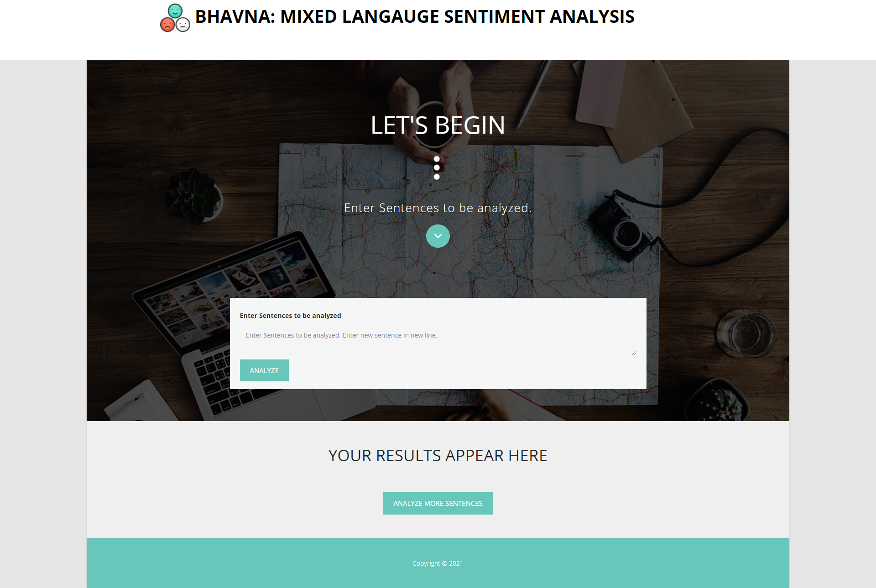
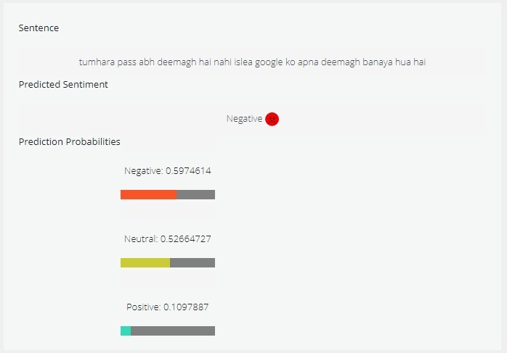
Results of a example sentence showing 'Negative' sentiment
Landing page of the website showing the input field. Multiple sentences can be analysed at once, they must be separated into new lines

Slide 8
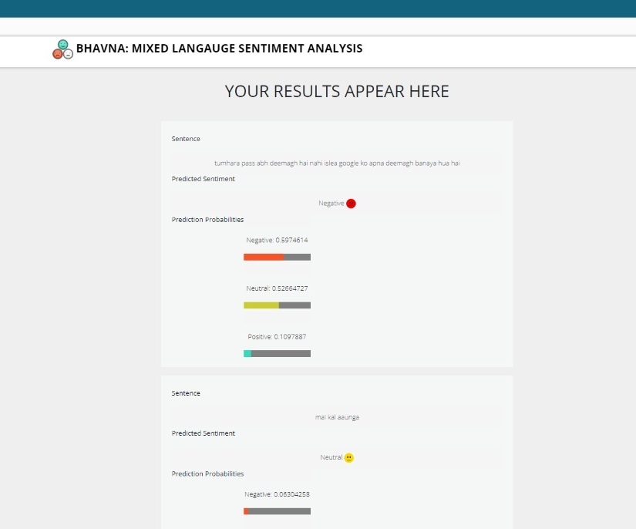
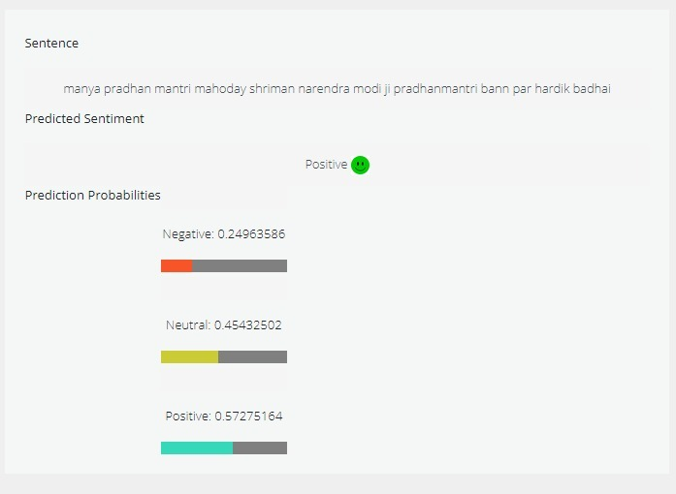
Results of a example sentence showing 'Positive' sentiment
Results are displayed below the input fields

Slide 9
References
[1] Bhargava, Rupal, Yashvardhan Sharma, and Shubham Sharma. "Sentiment analysis for mixed script indic sentences." 2016 International conference on advances in computing, communications and informatics (ICACCI). IEEE, 2016.
[2] Sharma, Shashank, P. Y. K. L. Srinivas, and Rakesh Chandra Balabantaray. "Text normalization of code mix and sentiment analysis." 2015 international conference on advances in computing, communications and informatics (ICACCI). IEEE, 2015.
[3] Sitaram, Dinkar, et al. "Sentiment analysis of mixed language employing Hindi-English code switching." 2015 International Conference on Machine Learning and Cybernetics (ICMLC). Vol. 1. IEEE, 2015.
[4]Prabhu, Ameya, et al. "Towards sub-word level compositions for sentiment analysis of hindi-english code mixed text." arXiv preprint arXiv:1611.00472 (2016).
[5] Balahur, Alexandra, et al. "Resource Creation and Evaluation for Multilingual Sentiment Analysis in Social Media Texts." LREC. 2014.

